Slide 1

Machine Learning
DSBA 6190-U91 | Colby T. Ford, Ph.D.

Slide 2
Overview
Intro to Machine Learning
Machine Learning in the Cloud
Cognitive Services
Basics of Algorithms
Regression
Classification
Clustering
Scaling Up with Parallelization
Training
Cross-Validation
Parameter Tuning

Slide 3
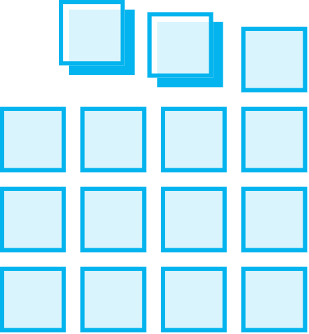
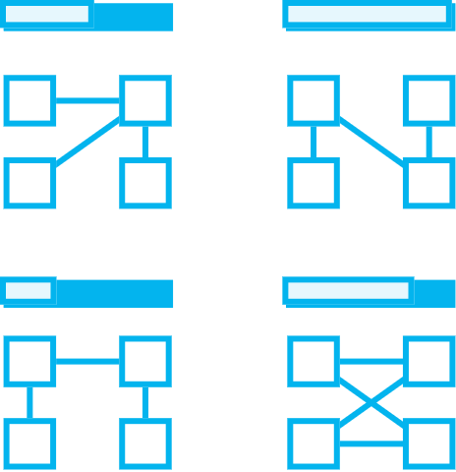


Intro to Machine Learning
Prepare Data
Build & Train
Deploy
Connect to various sources to ingest data
Train with the data to establish a model
Deploy the model and track performance

Slide 4

Machine Learning Options in the Cloud
Databricks
Machine Learning Studio
Machine Learning Services
DSVM
Me, too!

Slide 5
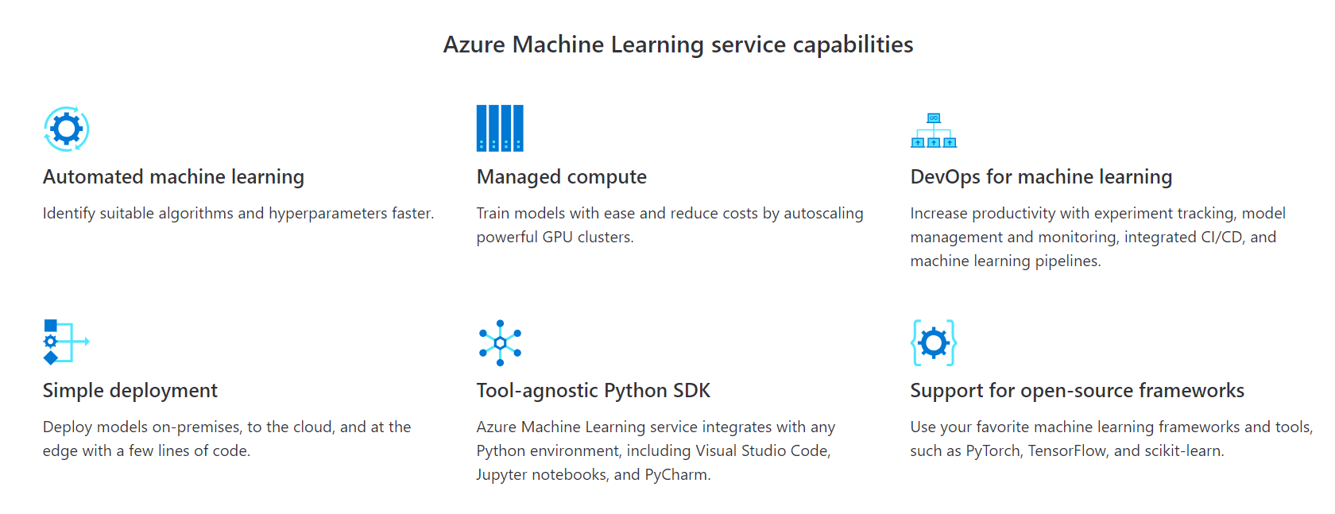
Azure Machine Learning Services
Simplify and accelerate the building, training, and deployment of your machine learning models. Use automated machine learning to identify suitable algorithms and tune hyperparameters faster. Improve productivity and reduce costs with autoscaling compute and DevOps for machine learning. Seamlessly deploy to the cloud and the edge with one click.
https://azure.microsoft.com/en-us/services/machine-learning-service/

Slide 6
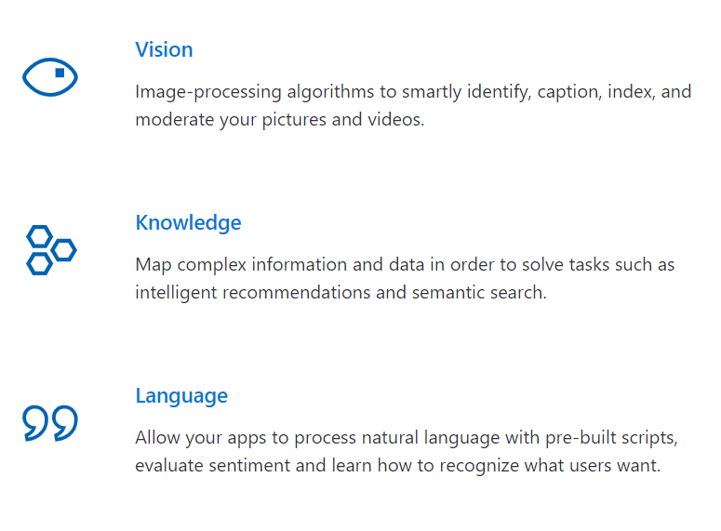

Microsoft Cognitive Services
Infuse your apps, websites and bots with intelligent algorithms to see, hear, speak, understand and interpret your user needs through natural methods of communication.
https://azure.microsoft.com/en-us/services/cognitive-services/

Slide 7
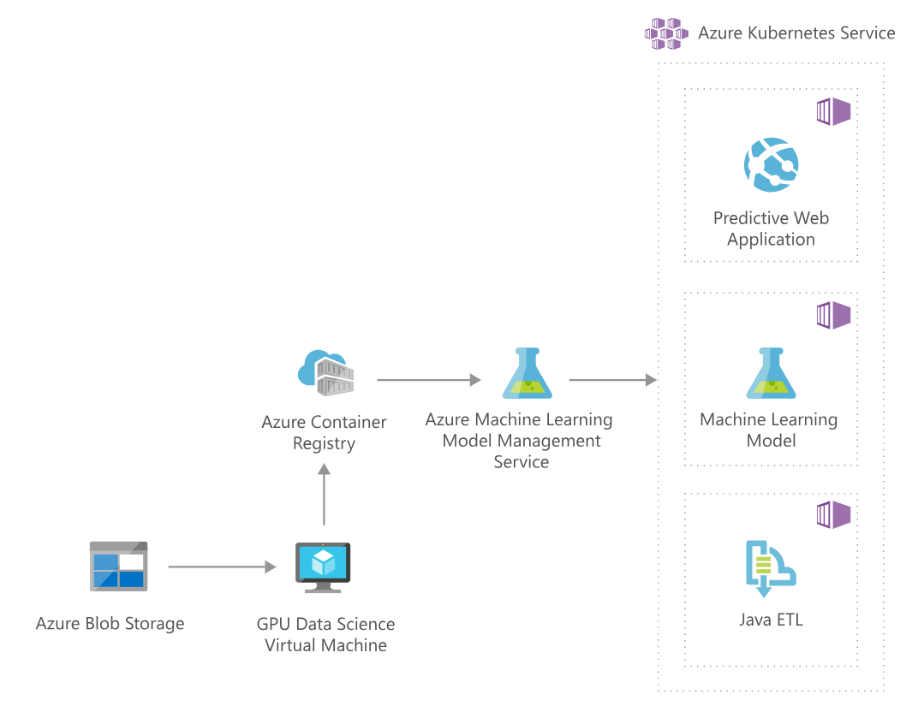
https://azure.microsoft.com/en-us/solutions/architecture/image-classification-with-convolutional-neural-networks/

Slide 8
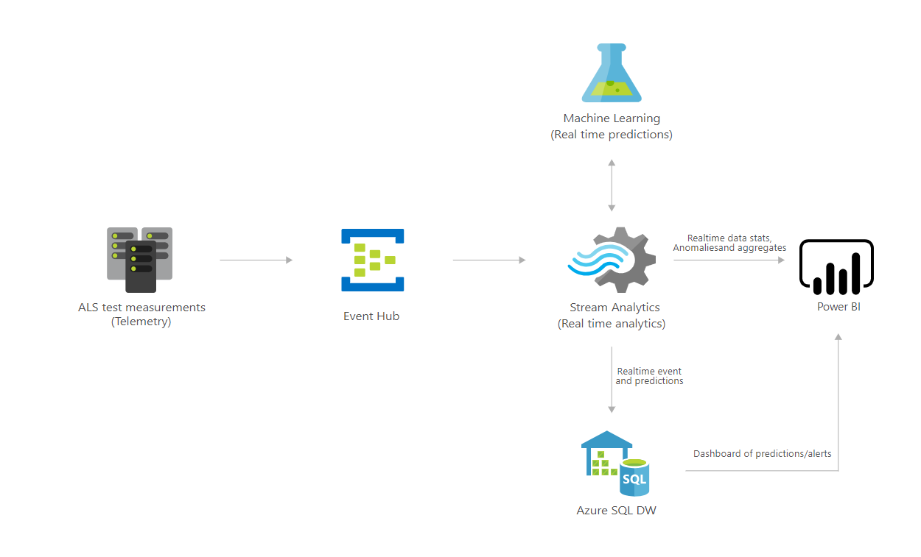
https://azure.microsoft.com/en-us/solutions/architecture/defect-prevention-with-predictive-maintenance/

Slide 9
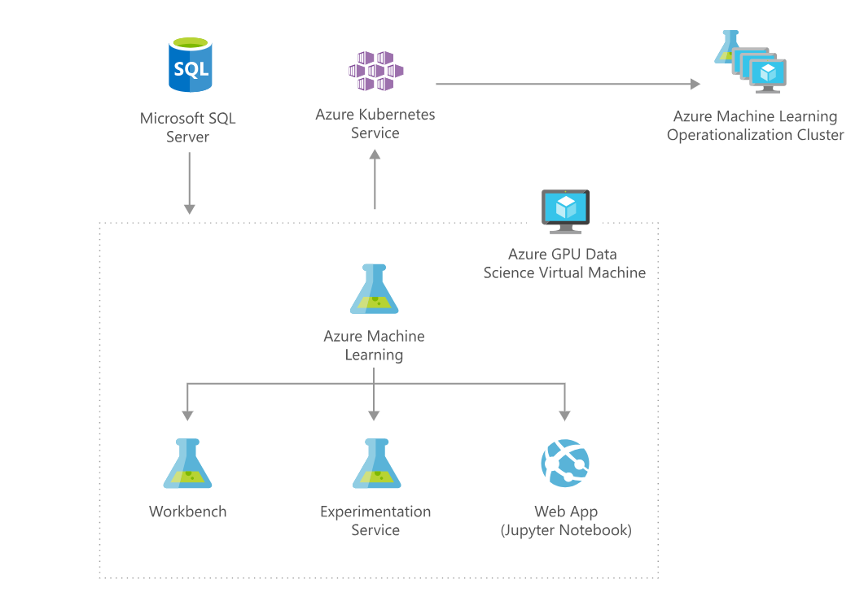
https://azure.microsoft.com/en-us/solutions/architecture/information-discovery-with-deep-learning-and-nlp/

Slide 11
Machine Learning Deep Dive
Overview of Algorithms:
Regression
Tree-Based Classification
Clustering
Computational Complexity

Slide 12
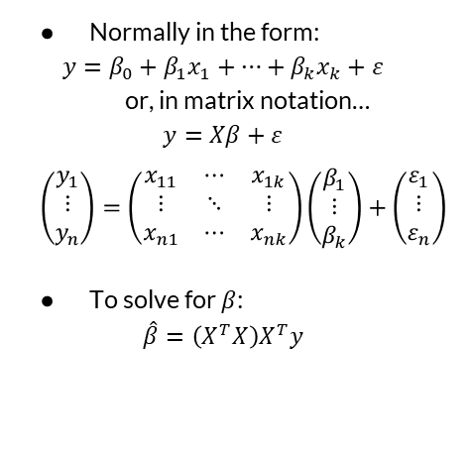
Linear Regression
## Load in data
data(mtcars)
## Define X matrix
X <- as.matrix(cbind(1,
mtcars$cyl,
mtcars$hp))
## Define y matrix
y <- as.matrix(mtcars$mpg)
## Solve for beta_hat
beta_hat <- solve(t(X)%*%X)%*%t(X)%*%y
## Fit the same data using lm
fit <- lm(mpg ~ cyl + hp,
data = mtcars)
fit$coefficients
Normally in the form:
$$y=β_{0}+β_{1}x_{1}+…+β_{k}x_{k}+ε$$
or, in matrix notation…
$$y=Xβ+ε$$
$$\left(\begin{matrix}y_{1} \\ ⋮ \\ y_{n}\end{matrix}\right)=\left(\begin{matrix}x_{11} & ⋯ & x_{1k} \\ ⋮ & ⋱ & ⋮ \\ x_{n1} & ⋯ & x_{nk}\end{matrix}\right)\left(\begin{matrix}β_{1} \\ ⋮ \\ β_{k}\end{matrix}\right)+\left(\begin{matrix}ε_{1} \\ ⋮ \\ ε_{n}\end{matrix}\right)$$
To solve for $β$:
$$\hat{β}=\left(X^{T}X\right)X^{T}y$$

Slide 13
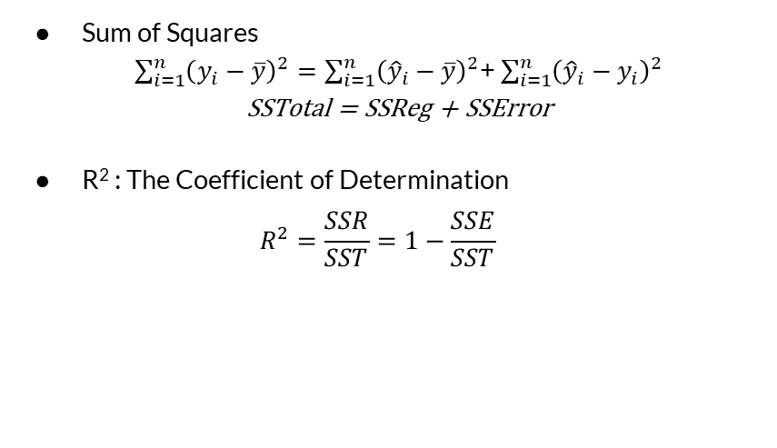
Regression Model Metrics
Sum of Squares
$\sum_{i=1}^{n}{{\left(y_{i}−\overline{y}\right)}^{2}}=\sum_{i=1}^{n}{{\left({\hat{y}}_{i}−\overline{y}\right)}^{2}}$+ $\sum_{i=1}^{n}{{\left({\hat{y}}_{i}−y_{i}\right)}^{2}}$
SSTotal = SSReg + SSError
R² : The Coefficient of Determination
$$R^{2}=\frac{SSR}{SST}=1−\frac{SSE}{SST}$$
Other things to look at:
P-Values
RMSE
MAPE

Slide 14
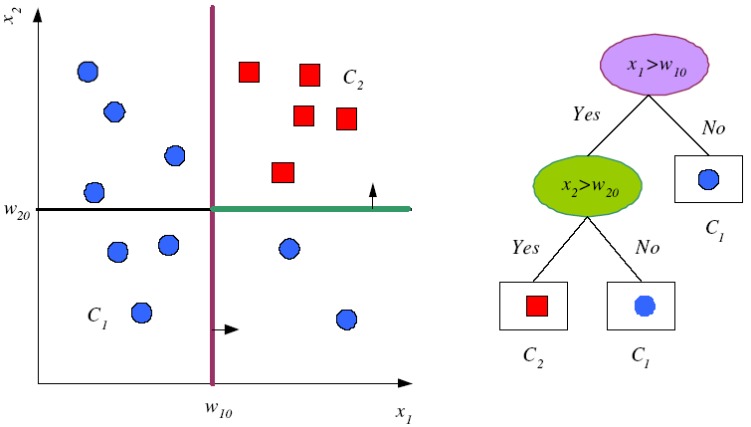
Tree-Based Classification
Decision Trees
Pick the most discriminable factor first, then continue to split]
Random Forests
Generate a bunch of random decision trees and vote on the most popular answer
Finishes based on some entropy/purity criterion
https://www.cmpe.boun.edu.tr/~ethem/i2ml3e/3e_v1-0/i2ml3e-chap9.pptx

Slide 15
Divide and Conquer
Internal decision nodes
Univariate: Uses a single attribute, x_{i}
Numeric x_{i} : Binary split : x_{i} > w_{m}
Discrete x_{i} : n-way split for n possible values
Multivariate: Uses all attributes, x
Leaves
Classification: Class labels, or proportions
Regression: Numeric; r average, or local fit
Learning is greedy; find the best split recursively (Breiman et al, 1984; Quinlan, 1986, 1993)

Slide 16
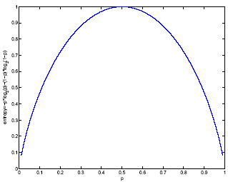
Classification Trees (ID3,CART,C4.5)
For node m, N_{m} instances reach m, N^{i}_{m} belong to C_{i}
Node m is pure if p^{i}_{m} is 0 or 1
Measure of impurity is entropy

Slide 17
Best Split
If node m is pure, generate a leaf and stop, otherwise split and continue recursively
Impurity after split: N_{mj} of N_{m} take branch j. N^{i}_{mj} belong to C_{i}
Find the variable and split that min impurity (among all variables -- and split positions for numeric variables)

Slide 18
Pruning Trees
Remove subtrees for better generalization (decrease variance)
Prepruning: Early stopping
Postpruning: Grow the whole tree then prune subtrees that overfit on the pruning set
Prepruning is faster, postpruning is more accurate (requires a separate pruning set)

Slide 19
“Accuracy is the best indication of a good model.” – Wrong People

Slide 20
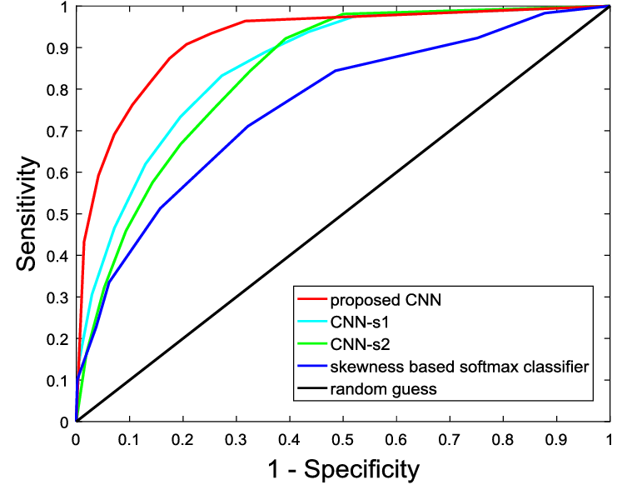
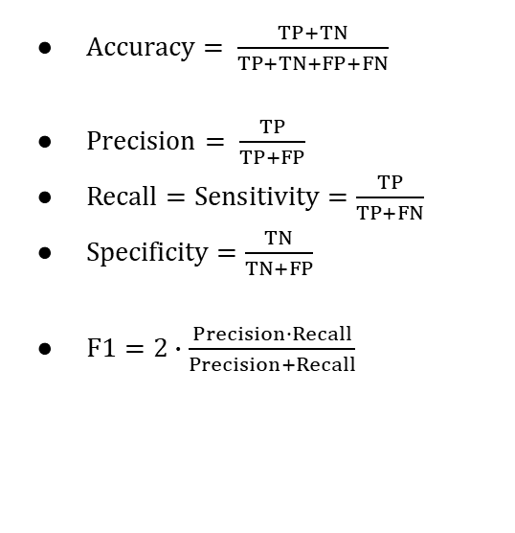
Classification Model Metrics
ROC Curve
A measure of the false positive rate vs. the true positive rate
$Accuracy= \frac{TP+TN}{TP+TN+FP+FN}$
$Precision= \frac{TP}{TP+FP}$
$Recall=Sensitivity=\frac{TP}{TP+FN}$
$Specificity=\frac{TN}{TN+FP}$
$F1=2∙\frac{Precision∙Recall}{Precision+Recall}$
https://www.researchgate.net/figure/ROC-curves-of-different-classifiers-The-ROC-curve-of-an-ideal-classifier-should-be_fig5_319939197

Slide 21
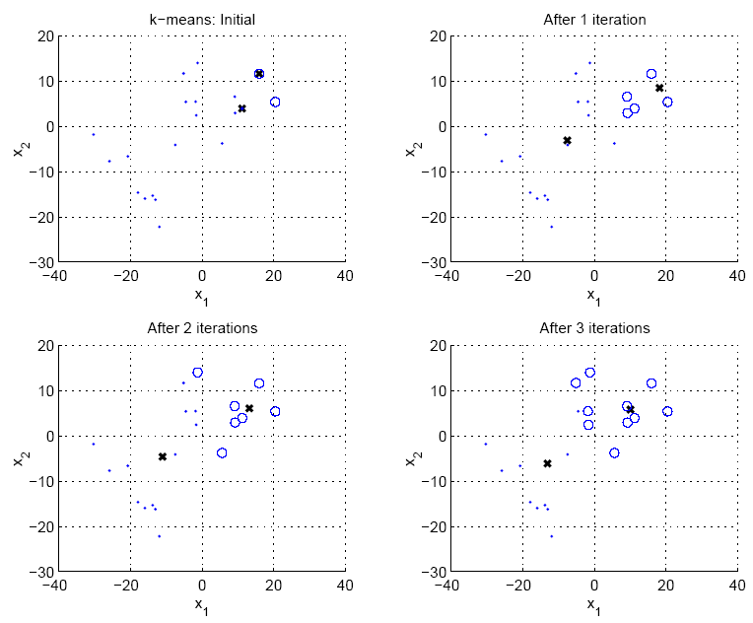
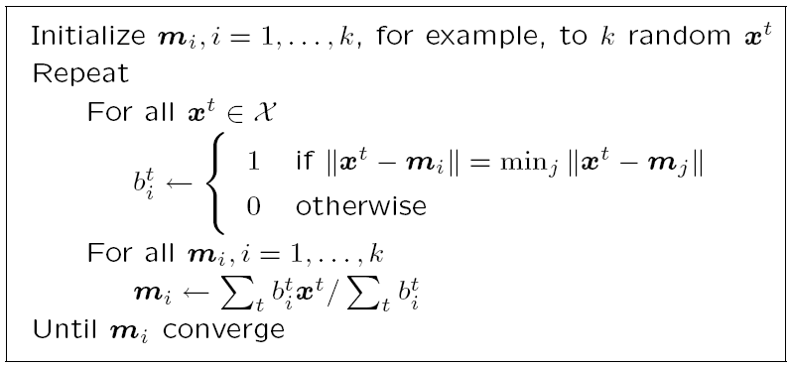
Clustering
Multiple methods:
Agglomerative – “Bottom-Up”
UPGMA
Divisive – “Top-Down”
k-Means
Based on some distance metric and some linkage criteria.
https://www.cmpe.boun.edu.tr/~ethem/i2ml3e/3e_v1-0/i2ml3e-chap7.pptx

Slide 22
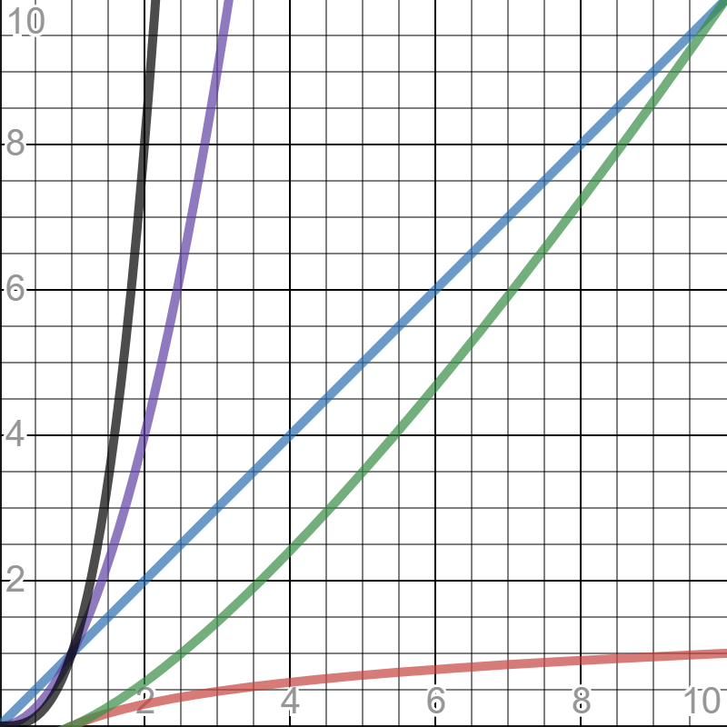
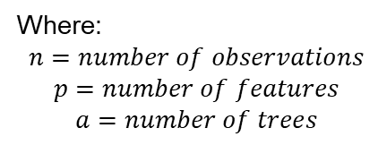
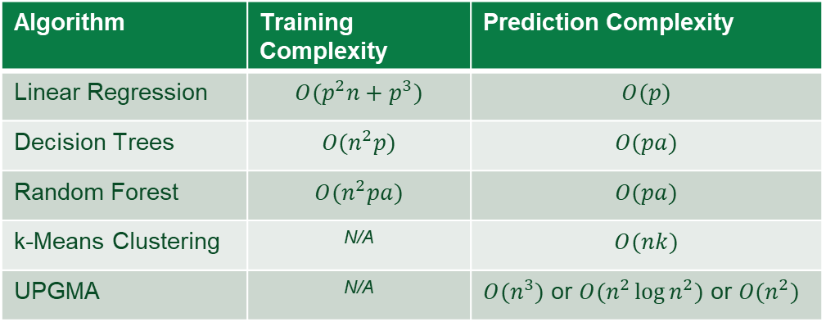
Computational Complexity
Algorithm | Training Complexity | Prediction Complexity
Linear Regression | $$O(p^{2}n+p^{3})$$ | $$O(p)$$
Decision Trees | $$O(n^{2}p)$$ | $$O(pa)$$
Random Forest | $$O(n^{2}pa)$$ | $$O(pa)$$
k-Means Clustering | N/A | $$O(nk)$$
UPGMA | N/A | $O(n^{3})$ or $O(n^{2}\log{n^{2}})$ or $O(n^{2})$
A measure of inherent difficulty in completing a computational task
In other words, if I increase the number of input points (either variables, observations, or parameters), by what factor does the computational time increase?
Where:
$$n=number of observations$$
$$p=number of features$$
$$a=number of trees$$
https://www.thekerneltrip.com/machine/learning/computational-complexity-learning-algorithms/

